Slide 1

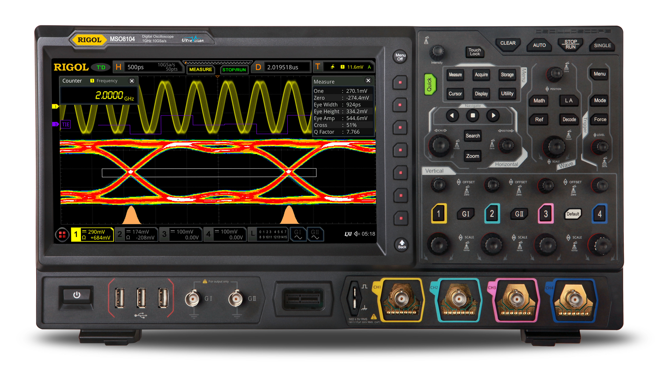
SQL to DBSP
compiler architecture
November 2023
Mihai Budiu
mbudiu@feldera.com

Slide 2
What is this?
A long reference document
Without a clear structure
Don’t try to follow or remember all the details
It is intended to document the architecture and implementation of the SQL to DBSP compiler
To help other people contribute or debug
It will be checked-in into the DBSP repository
Will be intermittently refreshed

Slide 3
DBSP
+
$$z^{−1}$$
DBSP is a programming language for writing incremental computations on databases
“Incremental View Maintenance”
Theoretical basis:
DBSP: Automatic Incremental View Maintenance for Rich Query Languages Mihai Budiu, Tej Chajed, Frank McSherry, Leonid Ryzhyk, and Val Tannen Proceedings of the VLDB Endowment (VLDB), Vancouver, Canada, August, 2023, pages 1601-1614
https://github.com/feldera/feldera is an open-source implementation of this programming language

Slide 4
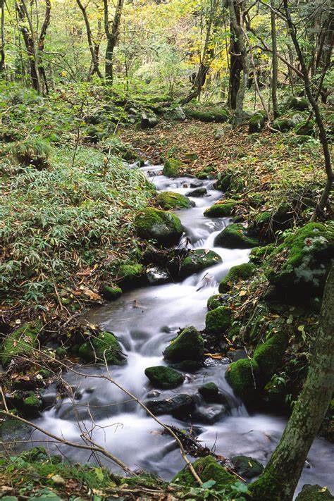
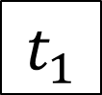
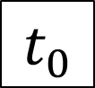
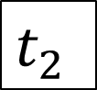
Streams
Consecutive values of an object
E.g., a table or a database view
Time is a “logical” clock, e.g., transaction count
$$t_{0}$$
$$t_{1}$$
$t_{2}$
…

Slide 5
Z-sets
Generalize sets
Each row has an integer weight
The weight can be positive, zero, or negative
Can represent both tables and changes to tables
Positive weights = elements added
Negative weights = elements removed
Generalize sets and multisets
Name | Age | Weight
Mike | 10 | 1
John | 12 | 3
Amy | 8 | -1
Chris | 10 | 2
tuples

Slide 6
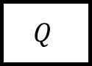
DBSP = computations on streams
Any number of inputs and outputs
Incremental computation:
Streams contain changes to inputs and outputs
(The compiler can optionally generate non-incremental computations)
query
…
$$Q$$
…
…
Streams of table values consecutive in time

Slide 7
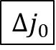
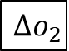
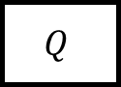
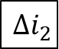
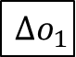
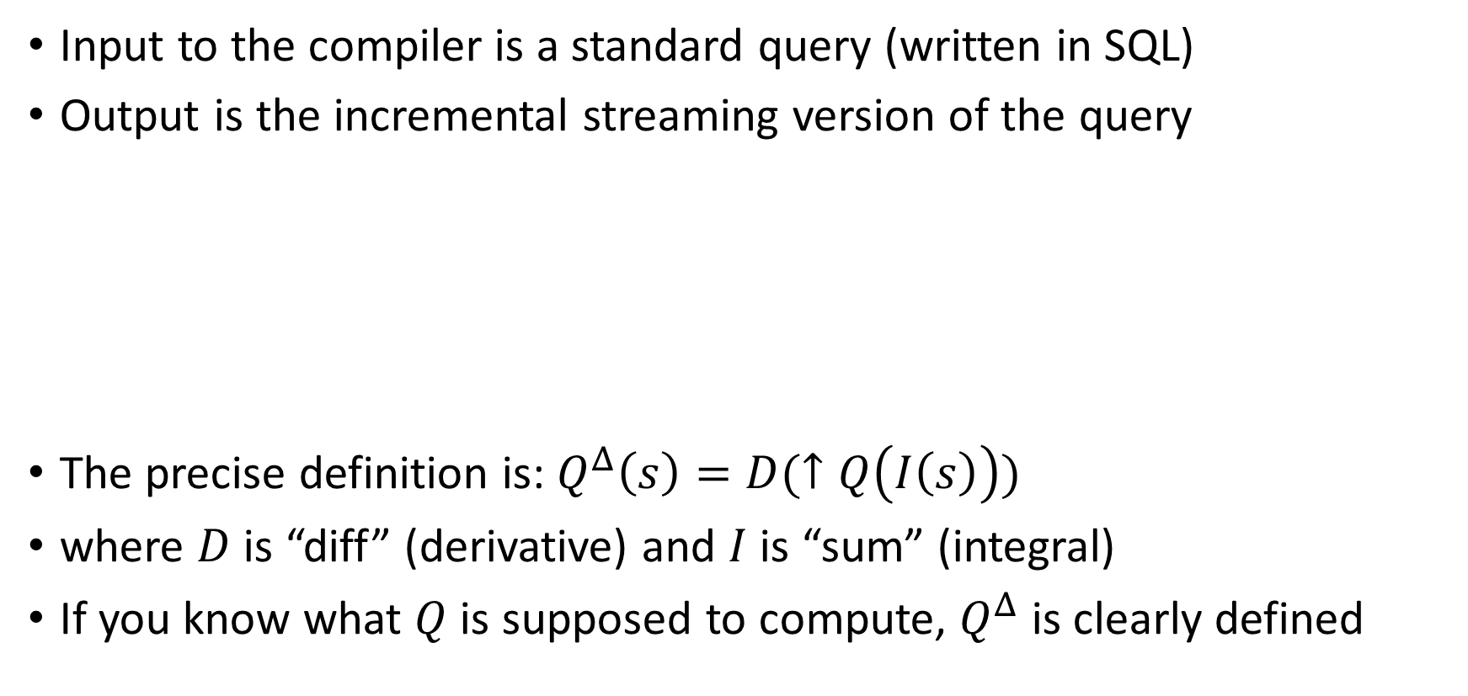

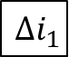
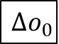
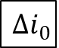
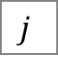
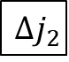
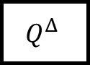
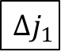
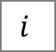
Incremental computations
Input to the compiler is a standard query (written in SQL)
Output is the incremental streaming version of the query
The precise definition is: $Q^{Δ}\left(s\right)=D(↑Q\left(I\left(s\right)\right))$
where $D$ is “diff” (derivative) and $I$ is “sum” (integral)
If you know what $Q$ is supposed to compute, $Q^{Δ}$ is clearly defined
sql-to-dbsp
compiler
$$i$$
$$Δi_{0}$$
$$Δi_{1}$$
$$Δi_{2}$$
…
$$Q$$
$$o$$
$$Q^{Δ}$$
$$Δo_{0}$$
$$Δo_{1}$$
$$Δo_{2}$$
…
$$j$$
$$Δj_{0}$$
$$Δj_{1}$$
$$Δj_{2}$$
…

Slide 8

SQL to DBSP compiler
https://github.com/feldera/dbsp/tree/main/sql-to-dbsp-compiler
MIT license
Generates programs using DBSP as a runtime
Written entirely in Java
Based on Apache Calcite https://calcite.apache.org

Slide 9
Example input program
-- create a table
CREATE TABLE Products ( ProductName VARCHAR NOT NULL, Price INT NOT NULL );
-- statements separated by semicolons
-- create a view
CREATE VIEW “Products Above Average Price” AS SELECT ProductName, Price FROM Products WHERE Price > (SELECT AVG(Price) FROM Products)
-- no semicolon at end

Slide 10
Describing streaming systems in SQL
CREATE VIEW V AS SELECT …
CREATE TABLE T ( … ) CREATE TABLE S ( … )
T
V
Dataflow graph
CREATE VIEW W AS SELECT …
S
W

Slide 11
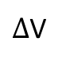
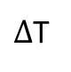
Compilation workflow: Rust output
Semantics of SQL (e.g., NULLs)
SQL runtime
$Δ$T
Compiler
rustc
SQL
Rust
exe
$Δ$V
DBSP runtime
Language-independent streaming lib
https://github.com/feldera/feldera

Slide 12
Compilation workflow
Type inference
CalciteCompiler
Calcite SQL parser (DDL)
SqlToRel
Optimize (Hep)
CalciteTo DBSP Compiler
Circuit
Opt.
Rust backend
SQL
Calcite IRs
DBSP IR
frontend
backend

Slide 13
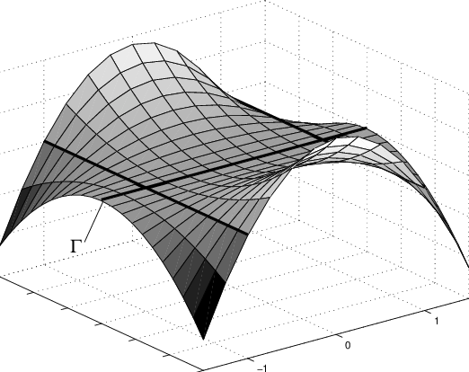
Optimizing Streaming Queries
Streaming systems generate plans before data is available!
No cost model or data statistics
Whatever plan you pass to DBSP, that’s what it runs!
Query planning performed using Calcite
In principle any optimizer should work
But we want to avoid bugs in some Calcite optimization Rules
We found quite a few bugs in Calcite optimization rules
Our compiler does some local optimizations

Slide 14
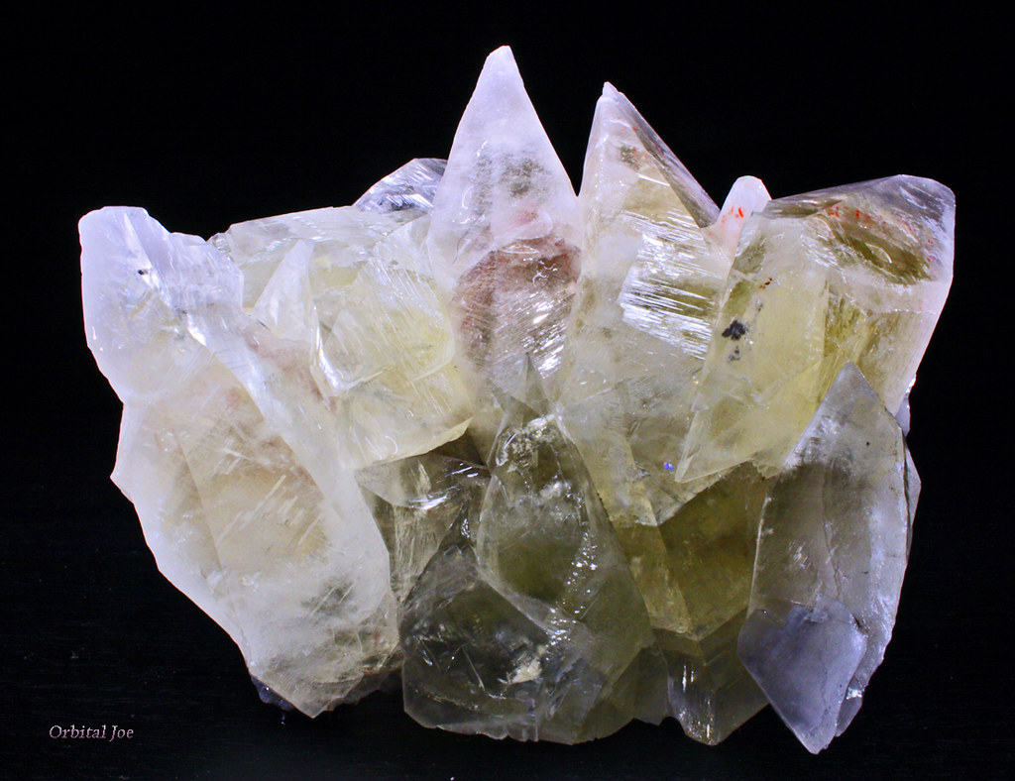
Calcite HEP Planner
A Calcite optimizer where you write a manual optimization plan
A plan is a list of rewrite rules
Currently applying:
Decorrelate queries (into joins)
Join order
Constant folding (*_REDUCE_EXPRESSIONS)
Empty collections (PruneEmptyRules)
Distinct aggregates converted to joins
Dead code (*_REMOVE)
Many more rules are available
Hard to validate rules, and, especially, rule combinations!

Slide 15
DBSP Core Intermediate Representation (IR)
Immutable
Can represent a small subset of Rust
Some classes are used for SQL compilation
Some classes are only used for test generation (e.g., for expressions). Annotated with @NonCoreIR
A bit higher-level than Rust (e.g., “Fold” is one operator)
Strongly-typed
DAG structure
No parent pointers
IR sub-dags can be reused
Manipulated almost exclusively by visitors
shared sub-DAG

Slide 16

Base class DBSPNode
public abstract class DBSPNode { /** Original Calcite object that produced this node. */ private final CalciteObject node;
/** Globally-unique ID for each node */ public final long id;
public String toString();
}
Compiler should be deterministic
Can insert breakpoints based on node id

Slide 17

Two-level Core IR representation
DBSP is a 2-level language:
Operators (e.g., “map”, “flatmap”, “join”)
Parameterized by functions (operating on tuples)
Circuits = dataflow graph of operators
All nodes implement IDBSPOuterNode interface
Functions = computations invoked by operators on their input data
IDBSPInnerNode interface
IR cannot yet represent recursion

Slide 18
IR Example
Circuit - outer
Function (Rust closure) - inner
move |t: &Tuple3<Option<i32>, Option<i32>, Option<i32>>, | -> Tuple1<Option<i32>> { Tuple1::new(plus_i32N_i32N( minus_i32N_i32N( div_i32_i32N(32i32, t.2), (match t.1 { Some(x) => Some(-(x)), _ => None, })), times_i32_i32N(-73i32, t.1))) }
MapOperator

Slide 19
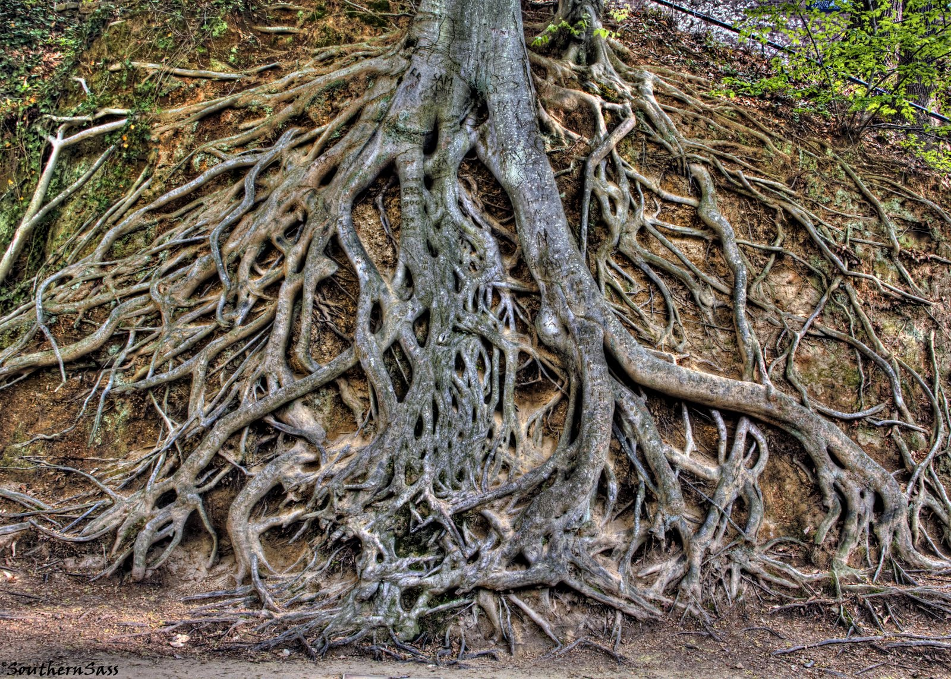
Root of class hierarchy
~24 classes
DBSPComment
IDBSPOuterNode
DBSPOperator
DBSPCircuit
…
IDBSPNode
DBSPPattern
…
IDBSPInnerNode
DBSPType
…
DBSPExpression
…
~120 classes
DBSPStatement
…
DBSPath
…
DBSPAggregate
DBSPFunction

Slide 20
Example inner IR classes
abstract class DBSPExpression extends DBSPNode implements IHasType, IDBSPInnerNode { protected final DBSPType type; … }
class DBSPBinaryExpression extends DBSPExpression { public final DBSPExpression left; public final DBSPExpression right; public final DBSPOpcode operation;
}

Slide 21
Operators
abstract class DBSPOperator extends DBSPNode implements IHasName, IHasType, IDBSPOuterNode { public final List<DBSPOperator> inputs; public final String operation; public final DBSPExpression function; public final String outputName; public final DBSPType outputType; public final boolean isMultiset; public final String comment; }

Slide 22
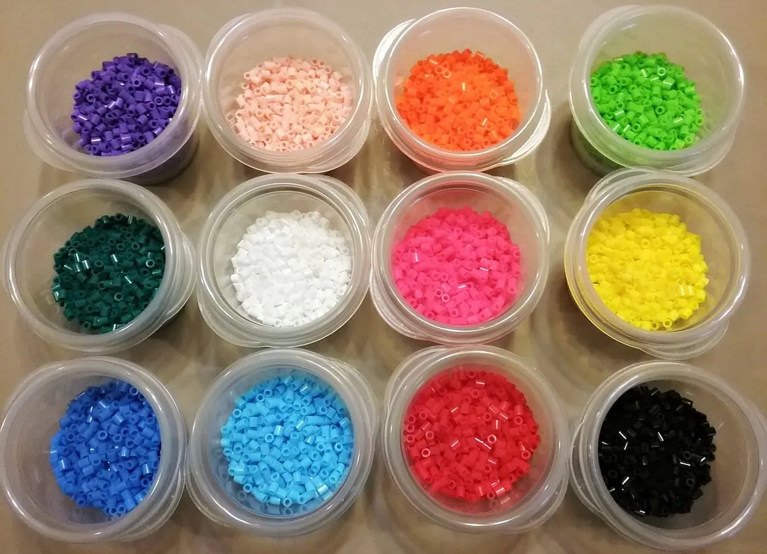
Types
All SQL types are base types (DBSPTypeBaseType)
Used in SQL: Integers, Booleans, but also Date, Time, String, MonthsInterval, null
Supporting: USize, Weight, Str
Calcite and Java do not support unsigned types, but the IR has them
Derived types
Tuple (hand-made), raw tuple (Rust), struct, vector, zset, user-defined
Semigroup types (for aggregates) – should probably be removed
TypeAny for types we don’t want to write (_)
Implementations must implement rust Ord trait (f32 doesn’t!)

Slide 23

Visitor pattern
https://en.wikipedia.org/wiki/Visitor_pattern
“In object-oriented programming and software engineering, the visitor design pattern is a way of separating an algorithm from an object structure on which it operates. A practical result of this separation is the ability to add new operations to existing object structures without modifying those structures.”
“Structure” = IR
“Algorithms” = program manipulations

Slide 24

Two-level visitor infrastructure
CircuitVisitor (base class) operates on circuits
implements Function<DBSPCircuit, DBSPCircuit>
Read-only visitors
Rewriting visitors
InnerVisitor (base class) operates on functions inside operators
implements Function<IDBSPInnerNode, IDBSPInnerNode>
Read-only visitors
Rewriting visitors

Slide 25
IR Manipulation (base classes)
Base | Visitor | Description
IRTransform | InnerVisitor | Operates on functions; read-only.
 | InnerRewriteVisitor | Rewrites types, expressions, statements.
 | InnerPasses | Runs in sequence several IRTransform.
 | InnerRepeat | Repeats an IRTransform until convergence.
CircuitTransform | CircuitVisitor | Operates on the circuit; read-only.
 | CircuitCloneVisitor | Operates on the circuit operators only; rewrites circuit.
 | CircuitRewriter | Rewrites a circuit using an IRTransform, including operator functions.
 | Passes | Runs a sequence of several CircuitTransform.
 | Repeat | Repeats a CircuitTransform until convergence.

Slide 26
IR rewriting using visitors
Input DAG
Output DAG
visitor
Modified DAG
Dead code
New DAG

Slide 27
Structure of read-only visitors
One preorder method for each node, returning VisitDecision
If the method returns STOP, visit stops immediately
One postorder method for each node, returning void
Flow:
class DBSPBinaryExpression extends DBSPExpression {
@Override public void accept(InnerVisitor visitor) { if (visitor.preorder(this).stop()) return; visitor.push(this); if (this.type != null) this.type.accept(visitor); this.left.accept(visitor); this.right.accept(visitor); visitor.pop(this); visitor.postorder(this); }
}

Slide 28
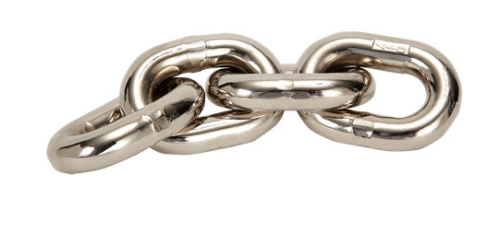
Chaining visitors
IDBSPInnerNode node;
InnerVisitor v1, v2;
IDBSPInnerNode intermediate = v1.apply(node);
IDBSPInnerNode final = v2.apply(intermediate);
node
intermediate
final
v1
v2

Slide 29
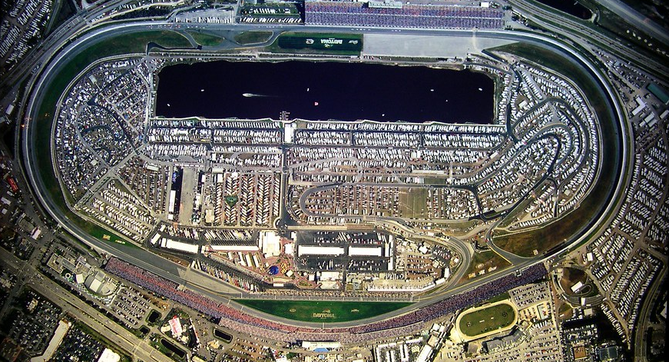
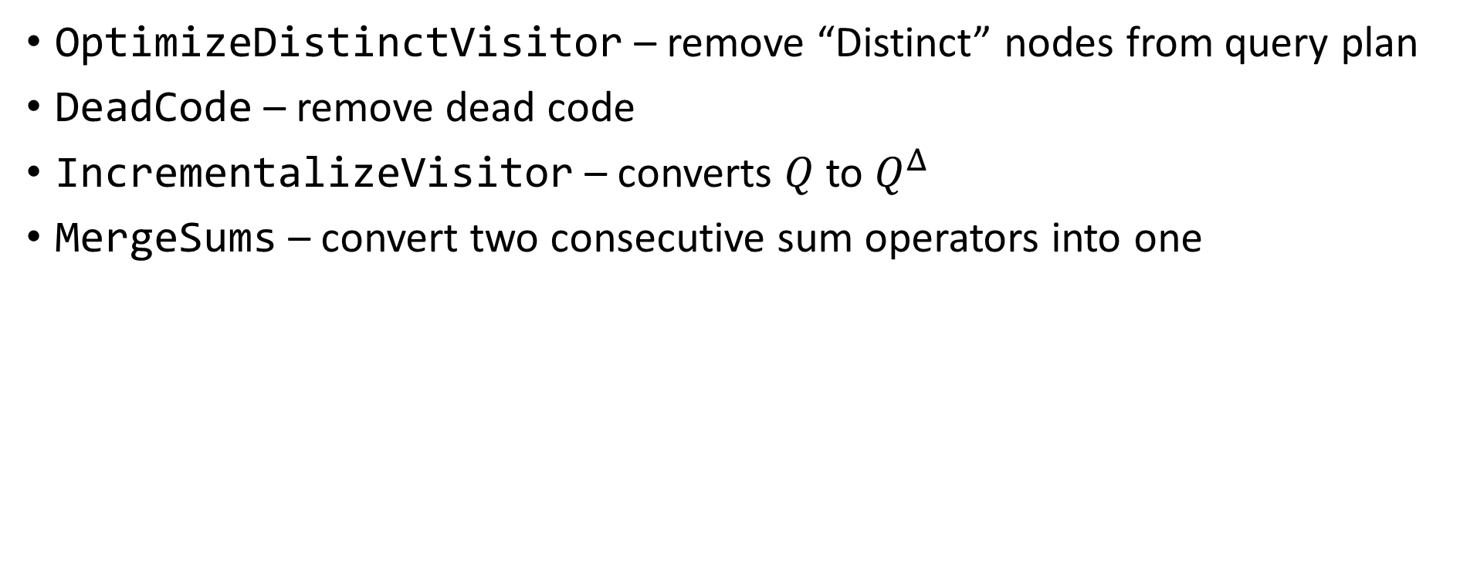
Example circuit visitors
OptimizeDistinctVisitor – remove “Distinct” nodes from query plan
DeadCode – remove dead code
IncrementalizeVisitor – converts $Q$ to $Q^{Δ}$
MergeSums – convert two consecutive sum operators into one

Slide 30

Recipe: Extending the IR
Add a new class to the proper package (e.g., expressions, types, etc.)
Derive from the right interface (IDBSPInnerNode or IDBSPOuterNode)
Implement the accept method
Add the suitable preorder & postorder methods to the OuterVisitor and InnerVisitor base classes
Add other implementations of preorder/postorder at other visitors (e.g., code generators)

Slide 31
CircuitCloneVisitor and inheritors
Use the postorder method
Use the “mapped” method to get the rewritten operator inputs
Use the “map” method to set the rewrite result
Don’t forget to call super.postorder for default behaviors
Example: swap “filter” with “distinct”:
void postorder(DBSPFilterOperator filter) { DBSPOperator input = this.mapped(filter.input()); if (input.is(DBSPDistinctOperator.class)) { DBSPOperator newFilter = filter.withInputs(input.inputs, false); this.addOperator(newFilter); DBSPOperator result = input.withInputs(Linq.list(newFilter), false); this.map(filter, result); } else super.postorder(filter); }

Slide 32

InnerRewriteVisitor and inheritors
Use the “preorder” method
Results are returned using the “map” method of the visitor
Recurse using the “transform” method
Example:
VisitDecision preorder(DBSPIsNullExpression expression) { this.push(expression); DBSPExpression source = this.transform(expression.expression); this.pop(expression); DBSPExpression result = expression; if (!source.getNonVoidType().mayBeNull) result = DBSPBoolLiteral.FALSE; this.map(expression, result); return VisitDecision.STOP; }

Slide 33

Rust code generation
Mostly handed by ToRustVisitor and ToRustInnerVisitor (or ToRustHandleVisitor)
RustFileWriter handles one-off tasks:
Some optimizations
Lowering representation (e.g., Aggregates)
Generating preambles (Rust use statements, Tuple definitions)
Generating Rust code

Slide 34

Testing
A few small unit tests (~600)
Mostly regression tests
Postgres test suite
SqlLogicTest (5-7M tests, not run in CI)

Slide 35
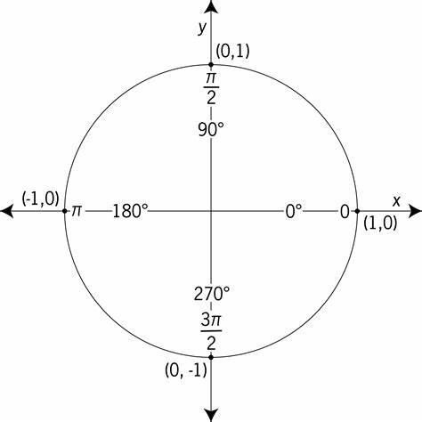
Unit tests
3 parts:
Query (table & view definitions)
Input data
Output data
IR can be used to represent constant values (ZSets, tuples)
Each test generates
A Rust function implementing the query as a fn mut(in0, in1) -> (out0, out1)
A Rust function invoking the query function on specified inputs and comparing outputs with expected results

Slide 36
BaseSQLTests
Provides many test utilities
Collects all rust test cases and runs them at the end in batch
To override:
testOptions() – options used for the current set of tests
testCompiler() – compiler used for the current set of tests
prepareTests(DBSPCompiler) – prepare a set of tests (usually by creating and filling tables.)

Slide 37

Example unit test in Java
DBSPCompiler compiler = testCompiler(); compiler.compileStatements(statements); DBSPCircuit circuit = getCircuit(compiler); InputOutputPair io = new InputOutputPair( new DBSPZSetLiteral.Contents[] { new DBSPZSetLiteral.Contents(e0, e1) }, new DBSPZSetLiteral.Contents[] { new DBSPZSetLiteral.Contents( new DBSPTupleExpression(DBSPBoolLiteral.TRUE), new DBSPTupleExpression(DBSPBoolLiteral.FALSE)), new DBSPZSetLiteral.Contents( new DBSPTupleExpression(new DBSPI32Literal(10))) }); this.addRustTestCase(compiler, circuit, io);
This is tedious; there are better ways to do it – see Postgres tests later in the presentation.

Slide 38

Sql Logic Test
From sqlite, public domain https://www.sqlite.org/sqllogictest/doc/trunk/about.wiki
5-7M+ tests
Factored out into a separate Java project https://github.com/hydromatic/sql-logic-test
No corner cases; only INTEGER, STRING, and DOUBLE
We use a real database for DDL & DML
Used Postgres and HSQLDB
We only compile and test the queries (not the statements)
Takes several weeks to run all tests using DBSP
Most of the time is spent in Rust compilation
Submitted a patch to Calcite
Takes 6 hours to run all tests on Calcite

Slide 39

Postgres test suite
https://github.com/postgres/postgres/blob/master/src/test/regress/expected
Input-output pairs
~240 test files in source
I implemented 4.5 of them
Not 100% compatible with Calcite SQL dialect
Require manual translation for each test case
Skipping the unsupported constructs

Slide 40
Writing a new Postgres tests
You can almost copy-paste code from the .out files
In a new test file:
Define a function prepareData(DBSPCompiler compiler) which creates and populates the tables that appear in the test. These may be created by the test_setup.out script
Create a new test using this.queryWithOutput:
this.queryWithOutput( "SELECT CAST(f1 AS varchar) AS \"varchar(char)\" FROM CHAR_TBL;\n" + " varchar(char) \n" + "---------------\n" + "a\n" + "ab\n" + "abcd\n" + "abcd");

Slide 41
Usage
$ cd sql-to-dbsp-compiler/SQL-compiler $ ./sql-to-dbsp
Usage: sql-to-dbsp [options] Input file to compile Options: -h, --help, -? Show this message and exit -O Optimization level (0, 1, or 2) -T Specify logging level for a class (can be repeated) -alltables Generate an input for each CREATE TABLE, even if the table is not used by any view -d SQL syntax dialect used Possible Values: [BIG_QUERY, ORACLE, MYSQL, MYSQL_ANSI, SQL_SERVER, JAVA] -f Name of function to generate -I Generate an incremental circuit -je Emit error messages as a JSON array to stderr -jpg Emit a jpg image of the circuit instead of Rust -js File containing schemas of all views and tables involved (in json) -o Output file; stdout if null -png Emit a png image of the circuit instead of Rust

Slide 42
Generated code
// CREATE TABLE T ( // COL1 INT NOT NULL, COL2 DOUBLE NOT NULL, COL3 BOOLEAN // NOT NULL, COL4 VARCHAR NOT NULL, COL5 INT, COL6 DOUBLE) let T = circuit.add_source(T);
let stream0: Stream<_, OrdZSet<Tuple1<bool>, Weight>> = T.map(move |t: &Tuple6<i32, F64, bool, String, Option<i32>, Option<F64>>, | -> Tuple1<bool> { Tuple1::new(or_b_b(t.2, gt_i32_i32(t.0, 10i32))) });
// CREATE VIEW V AS SELECT T.COL3 OR T.COL1 > 10 FROM T

Slide 43
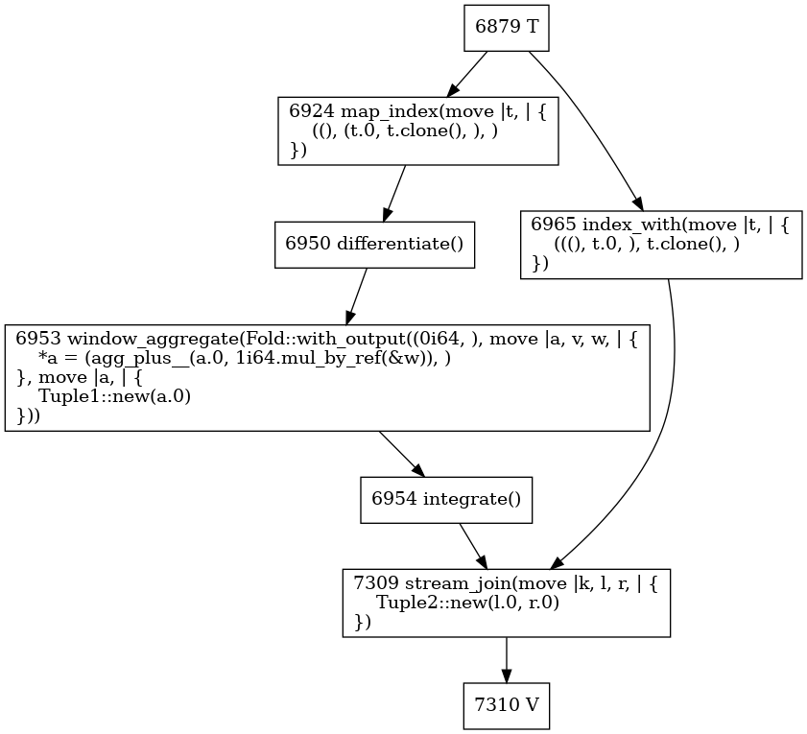
Example circuit topology output
node id
node operation
function
SELECT T.COL1, COUNT(*) OVER (ORDER BY T.COL1 RANGE UNBOUNDED PRECEDING) FROM T

Slide 44

Status
Core SQL language covered
Rust code generation covered for core SQL language
Tracked by https://github.com/feldera/dbsp/issues/172
Ran once all SQL Logic Tests successfully
But the compiler has changed since then
No SQL streaming extensions yet supported

Slide 45
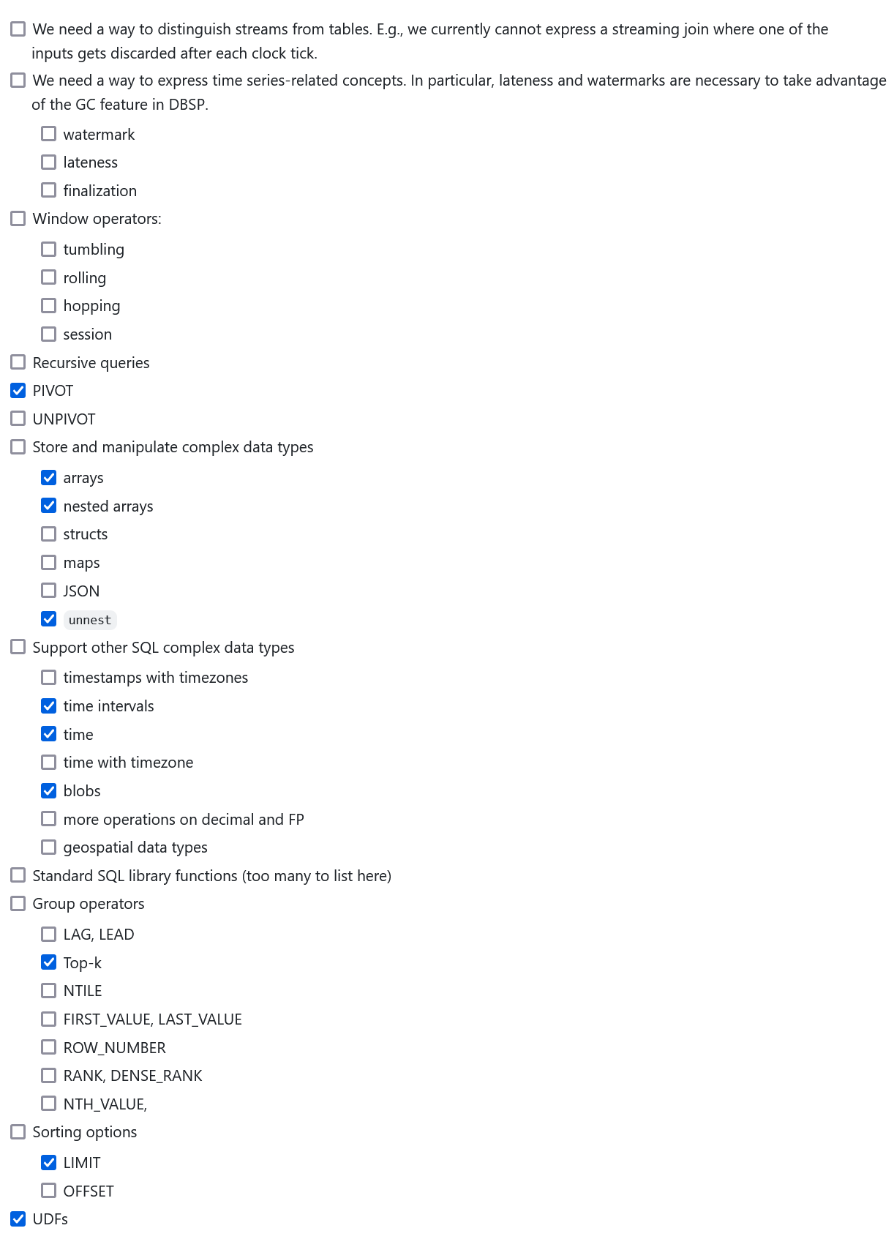
SQL feature wish list
dbsp/issues/172

Slide 46
SQL Runtime library
Implements the semantics of SQL on our chosen Rust representation
sql-to-dbsp-compiler/lib/
hashing – used for SLT testing using MD5 output checksums
readers – used for SLT testing to read CSV files
sqlvalue – used for SLT testing to convert values to strings
tuple – implementation of tuples with arbitrary number of arguments
sqllib – SQL functions
casts – type conversions
operators – plus, minus, and, or, etc with NULLs
geopoint – will have support for geographic data structures (only one now)
interval – time intervals
timestamp – dates and timestamps
string – string functions

Slide 47
Data types - scalar
SQL | Java | Rust
TINYINT | DBSPTypeInteger | i8
SHORTINT | DBSPTypeInteger | i16
INT | DBSPTypeInteger | i32
BIGINT | DBSPTypeInteger | i64
BOOLEAN | DBSPTypeBool | bool
DECIMAL(P,S) | DBSPTypeDecimal | rust_decimal::Decimal
REAL | DBSPTypeFloat | F32
DOUBLE | DBSPTypeDouble | F64
NULL | DBSPTypeNull | ()
CHAR, CHAR(N), VARCHAR, VARCHAR(N) | DBSPTypeString | String
https://github.com/feldera/feldera/blob/main/sql-to-dbsp-compiler/SQL-compiler/src/main/java/org/dbsp/sqlCompiler/compiler/frontend/TypeCompiler.java and
https://github.com/feldera/feldera/blob/main/sql-to-dbsp-compiler/SQL-compiler/src/main/java/org/dbsp/sqlCompiler/ir/type/DBSPTypeCode.java

Slide 48
Data types - complex
SQL | Java | Rust
BINARY(N), VARBINARY | DBSPTypeBinary | ByteArray
INTERVAL (short intervals) | DBSPTypeMillisInterval | ShortInterval
INTERVAL (long intervals) | DBSPTypeMonthsInterval | LongInterval
DATE | DBSPTypeDate | Date
TIME(N) | DBSPTypeTime | Time
TIMESTAMP(N) | DBSPTypeTimestamp | Timestamp
TIME WITH TIME ZONE | N/A | N/A
TIMESTAMP WITH TIME ZONE | N/A | N/A
TIME WITH LOCAL TIME ZONE | N/A | N/A
TIMESTAMP WITH LOCAL TIME ZONE | N/A | N/A
T VECTOR | DBSPTypeVec | Vec<T>
GEOMETRY | DBSPTypeGeoPoint | GeoPoint
SYMBOL | DBSPTypeKeyword | N/A
ANY | DBSPTypeAny | _

Slide 49
One operator
pub fn eq_i16_i16(left: i16, right: i16) -> bool pub fn eq_i32_i32(left: i32, right: i32) -> bool pub fn eq_i64_i64(left: i64, right: i64) -> bool pub fn eq_i16N_i16(left: Option<i16>, right: i16) -> Option<bool> pub fn eq_i32N_i32(left: Option<i32>, right: i32) -> Option<bool> pub fn eq_i64N_i64(left: Option<i64>, right: i64) -> Option<bool> pub fn eq_i16_i16N(left: i16, right: Option<i16>) -> Option<bool> pub fn eq_i32_i32N(left: i32, right: Option<i32>) -> Option<bool> pub fn eq_i64_i64N(left: i64, right: Option<i64>) -> Option<bool> pub fn eq_i16N_i16N(left: Option<i16>, right: Option<i16>) -> Option<bool> pub fn eq_i32N_i32N(left: Option<i32>, right: Option<i32>) -> Option<bool> pub fn eq_i64N_i64N(left: Option<i64>, right: Option<i64>) -> Option<bool> pub fn eq_b_b(left: bool, right: bool) -> bool pub fn eq_bN_b(left: Option<bool>, right: bool) -> Option<bool> pub fn eq_b_bN(left: bool, right: Option<bool>) -> Option<bool> pub fn eq_bN_bN(left: Option<bool>, right: Option<bool>) -> Option<bool> pub fn eq_s_s(left: String, right: String) -> bool pub fn eq_sN_s(left: Option<String>, right: String) -> Option<bool> pub fn eq_s_sN(left: String, right: Option<String>) -> Option<bool> pub fn eq_sN_sN(left: Option<String>, right: Option<String>) -> Option<bool> pub fn eq_d_d(left: F64, right: F64) -> boolpub fn eq_f_f(left: F32, right: F32) -> bool pub fn eq_dN_d(left: Option<F64>, right: F64) -> Option<bool> pub fn eq_fN_f(left: Option<F32>, right: F32) -> Option<bool> pub fn eq_d_dN(left: F64, right: Option<F64>) -> Option<bool> pub fn eq_f_fN(left: F32, right: Option<F32>) -> Option<bool> pub fn eq_dN_dN(left: Option<F64>, right: Option<F64>) -> Option<bool> pub fn eq_fN_fN(left: Option<F32>, right: Option<F32>) -> Option<bool> pub fn eq_decimal_decimal(left: Decimal, right: Decimal) -> bool pub fn eq_decimalN_decimal(left: Option<Decimal>, right: Decimal) -> Option<bool> pub fn eq_decimal_decimalN(left: Decimal, right: Option<Decimal>) -> Option<bool> pub fn eq_decimalN_decimalN(left: Option<Decimal>, right: Option<Decimal>) -> Option<bool> pub fn eq_Timestamp_Timestamp(left: Timestamp, right: Timestamp) -> bool pub fn eq_TimestampN_Timestamp(left: Option<Timestamp>, right: Timestamp) -> Option<bool> pub fn eq_Timestamp_TimestampN(left: Timestamp, right: Option<Timestamp>) -> Option<bool> pub fn eq_TimestampN_TimestampN(left: Option<Timestamp>, right: Option<Timestamp>) -> Option<bool> pub fn eq_date_date(left: Date, right: Date) -> bool pub fn eq_dateN_date(left: Option<Date>, right: Date) -> Option<bool> pub fn eq_date_dateN(left: Date, right: Option<Date>) -> Option<bool> pub fn eq_dateN_dateN(left: Option<Date>, right: Option<Date>) -> Option<bool>
More will be needed.
Not all supported types are here.
Most of these are generated by Rust macros.

Slide 50
Library function signatures
pub fn eq_i32_i32N(left: i32, right: Option<i32>) -> Option<bool>
This pattern is used for polymorphic functions.
Non polymorphic functions have similar naming patterns, e.g.: chr_ and chrN.
Left argument
Right argument
Nullable type

Slide 51
Macros for generating functions
You write one function
The macros handle NULLs
These work when NULL inputs generate NULL outputs
Not always true
some_polymorphic_function1 – polymorphic functions with 1 arg
some_function – non-polymorphic functions with 1 arg
some_operator – functions implementing operators (e.g., plus)

Slide 52

Recipe: Adding new SQL features
Write a unit test
Run the test
Notice the location of the crash
Probably a throw Unimplemented()
Implement the missing function
Probably call some specific runtime function
Run the test again
Rust will fail to compile with unknown function
Implement the runtime function in sqllib/
Run the test again
Repeat

Slide 53
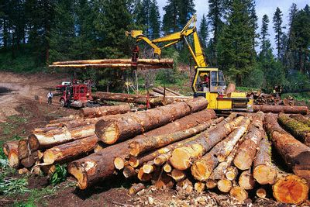
Logging
Message priority; higher -> less verbose
Logger.INSTANCE.belowLevel(this, 3) .append("After ") .append(this.visitor.toString()) .newline() .appendSupplier(result::toString) .newline();
Lazy evaluation using a function

Slide 54

Error handling
Compiler catches exceptions and converts them into messages
For debugging it can do the opposite too: throw at first error
Controlled by compilerOptions.optimizerOptions.throwOnError
Prefer to throw one of the exceptions deriving from BaseCompilerException:
InternalCompilerError – an assertion failure for broken invariants
UnimplementedException – something is not yet built, but should be
UnsupportedException – construct is not legal SQL or is not supported

Slide 55
Controlling the logging level
Logger.INSTANCE.setLoggingLevel(DBSPCompiler.class, 3); Logger.INSTANCE.setLoggingLevel(“CalciteCompiler”, 3);
On the command-line you can use the –T flag to control the logging level:
./sql-to-dbsp –TCalciteCompiler=2 –TDBSPCompiler=3…
Classes that implement IWritesLogs

Slide 56

Static and dynamic semantics
Constant expressions are evaluated by Calcite
Using a Java-based evaluator
Which depends on the Java type system
So it is difficult to add non-Java datatypes, e.g., UNSIGNED
May have bugs
Some functions have different behaviors depending on SQL dialect selected!
Other expressions are evaluated by the runtime
The results should agree
The runtime cannot unilaterally choose a semantics

Slide 57
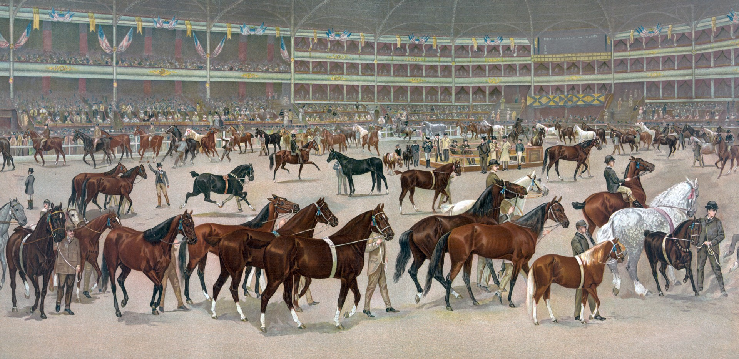
The operator menagerie
A description of the primitive DBSP operators and their use in the compiler

Slide 58
DBSP Operators
In the Rust code operators are created by calling methods on stream objects
(except source operators which have no inputs)
Some methods expand into complex operator graphs
Others expand into single operators
All inputs and outputs of all operators are (streams of) IndexedZSet
Each operator has a single output, except Output operators which have none
In Rust ZSet is a particular type of IndexedZSet, having always the () value
The following is a catalog of these operators

Slide 59
Input operators

Slide 60
Input
File: input.rs
Method: circuit methods; add_input_stream(), add_input_zset(), add_input_indexed_zset(), add_input_set(), add_input_map()
Inputs: None
Output: ZSet or IndexedZSet
Method parameters: None
Behavior: Creates a handle that adapters can use to insert data
Primitive: yes
Circuit scope: only outer scope

Slide 61
CsvSource
File: csv.rs
Method: from_reader(reader), from_csv_reader(reader)
Inputs: None
Output: ZSet
Method parameters: reader
Behavior: Reads data from a specified CSV file
Primitive: yes
Circuit scope: only outer scope

Slide 62
Generator
File: generator.rs
Method: no stream method, created using new()
Inputs: None
Output: Any
Method parameters: function generating values
Behavior: every time it is called the generating function is used to produce a new value
Primitive: yes
Circuit scope: only outer scope

Slide 63
GeneratorNested
File: generator.rs
Method: no stream method, created using new
Inputs: None
Output: Any
Method parameters: function generating function generating outputs
Behavior: at each outer clock tick the generator generates a new function that will be used to generate a stream
Primitive: yes
Circuit scope: outer scope?

Slide 64
Output operators

Slide 65
Output
File: output.rs
Method: output()
Inputs: Any
Output: None
Method parameters: None
Behavior: Produces a handle that can be used to read data from the circuit
Primitive: yes
Circuit scope: outer

Slide 66
OutputGuarded
File: output.rs
Method: output_guarded()
Inputs: Any, A stream of Boolean values (not a ZSet!)
Output: None
Method parameters: None
Behavior: outputs values from left stream when Boolean value is true, else outputs empty values
Primitive: yes
Circuit scope: outer

Slide 67
Primitive operators

Slide 68
Inspect
File: inspect.rs
Method: inspect()
Inputs: Any
Output: Same as input
Method parameters: A callback invoked for all inputs
Behavior: Callback is invoked for every new input, output is the input unchanged
Primitive: yes
Circuit scope: any

Slide 69
Export
File: circuit_builder.rs
Method: export()
Inputs: Any
Output: Same as input
Method parameters: None
Behavior: Moves a stream from an inner scope to an outer scope (only the current element is exposed when inner scope terminates)
Primitive: yes
Circuit scope: inner

Slide 70
FilterKeys
File: filter_map.rs
Method: filter(predicate)
Inputs: ZSet
Output: ZSet
Method parameters: filtering predicate
Behavior: Applies the predicate to each data item in the input Zset, keeps items where predicate is true
Primitive: yes
Circuit scope: any
Time complexity: O(|input|), Space complexity: 0

Slide 71
FilterVals
File: filter_map.rs
Method: filter(predicate)
Inputs: IndexedZSet
Output: IndexedZSet
Method parameter: Filtering predicate with two arguments
Behavior: Applies the filter to each (k,v) pair in the input
Primitive: yes
Circuit scope: any
Time complexity: O(|input|), Space complexity: 0

Slide 72
Map
File: filter_map.rs
Method: map_generic(func), map_index_generic(func), map(func), map_index(func)
Inputs: 1 any
Output: Same as input
Method parameters: Mapping function
Behavior: transforms each tuple in the input using the mapping function to produce an output tuple with the same weight
Primitive: yes
Circuit scope: any
Time complexity: O(|input|), Space complexity: 0

Slide 73
MapKeys
File: filter_map.rs
Method: map_generic(func)
Inputs: ZSet
Output: ZSet
Method parameters: Function from tuple to tuple
Behavior: Applies the mapping function to each input tuple to produce an output tuple with the same weight
Primitive: yes
Circuit scope: any
Time complexity: O(|input|), Space complexity: 0

Slide 74
FlatMap
File: filter_map.rs
Method: flat_map_generic(iter), flat_map_index_generic(iter), flat_map(iter), flat_map_index(iter)
Inputs: any
Output: same as input
Method parameters: function that produces an iterator from each input. Function can take either keys, or key-value pairs
Behavior: Substitute the input tuple with all the tuples in the collection produced by the function with the original weight
Primitive: yes
Circuit scope: any
Time complexity: O(|input|), Space complexity: 0

Slide 75
Z1
File: z1.rs
Method: delay()
Inputs: Any 1
Output: Same as input
Method parameters: None
Behavior: Produces output one step after the input
Primitive: yes
Circuit scope: any
Time complexity: O(|input|), Space complexity: O(|input|)

Slide 76
Z1Nested
File:.rs
Method: delay_nested()
Inputs: Any 1
Output: Same as input
Method parameters: None
Behavior: Produces the input stream in the next clock cycle, remembering all its values
Primitive: yes
Circuit scope: at least 1 level deep
Time complexity: O(|input|), Space complexity: O(|max iterations|)

Slide 77
Consolidate
File: consolidate.rs
Method: consolidate()
Inputs: any 1
Output: any
Method parameters: none
Behavior: combines a trace into a batch: each tuple appears only once
Primitive: yes
Circuit scope: outer
Time complexity: O(|input|), Space complexity: 0

Slide 78
Plus
File: plus.rs
Method: plus()
Inputs: two streams of the same type, any type
Output: same type as input stream
Method parameters: none
Behavior: Computes ZSet or IndexedZSet multiset plus
Primitive: yes
Circuit scope: any
Time complexity: O(|left|+|right|), Space complexity: 0

Slide 79
Minus
File: plus.rs
Method: minus()
Inputs: two streams of the same type, any type
Output: same kind as input streams
Method parameters: none
Behavior: computes left – right as ZSets
Primitive: yes
Circuit scope: yes
Time complexity: O(|left|+|right|), Space complexity: 0

Slide 80
UnaryMinus
File: neg.rs
Method: neg()
Inputs: any 1
Output: same type as input
Method parameters: none
Behavior: produces the negated input ZSet or IndexedZSet by negating all weight
Primitive: yes
Circuit scope: any
Time complexity: O(|input|), Space complexity: 0

Slide 81
Apply, ApplyOwned
File: apply.rs
Method: apply(transform), apply_named(transform, name), apply_owned(transform), apply_owned_named(transform, name)
Inputs: Any 1
Output: Any
Method parameters: Transform that is applied to the entire input ZSet or IndexedZSet
Behavior: Apply transform to entire input
Primitive: yes
Circuit scope: outer (no fixedpoint support)
Time complexity: O(|input|), Space complexity: 0

Slide 82
ApplyCore
File: apply.rs
Method: apply_core(…)
Inputs: any 1
Output: any
Method parameters: like apply, plus function that decides when a fixedpoint has been reached
Behavior: Apply the function to every input
Primitive: Yes
Circuit scope: any
Time complexity: O(|input|), Space complexity: 0

Slide 83
Apply2, Apply2Owned
File: apply2.rs
Method: apply2(transform), apply2_owned(transform)
Inputs: 2 any type
Output: any type
Method parameters: transform
Behavior: Apply transform to both inputs at every step to produce the output
Primitive: yes
Circuit scope: outer (no fixpoint support)
Time complexity: O(|input|), Space complexity: 0

Slide 84
Apply3
File: apply3.rs
Method: apply3(transform)
Inputs: any 3 inputs
Output: any
Method parameters: transform to apply
Behavior: Apply transform to all inputs at every step to produce output
Primitive: yes
Circuit scope: outer (no fixpoint support)
Time complexity: O(|input|), Space complexity: 0

Slide 85
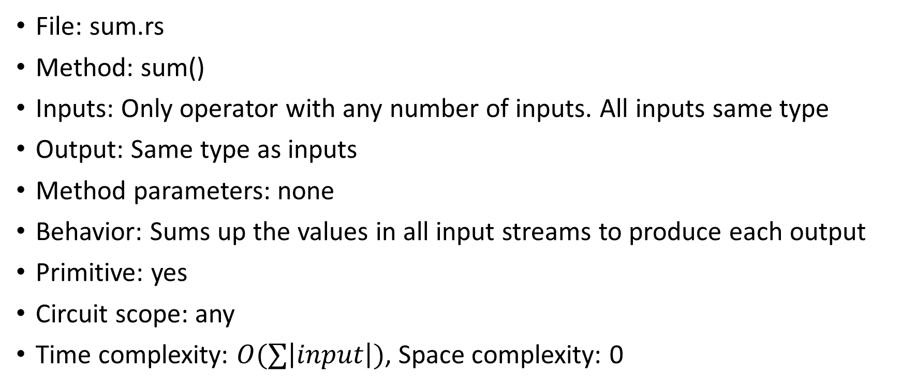
Sum
File: sum.rs
Method: sum()
Inputs: Only operator with any number of inputs. All inputs same type
Output: Same type as inputs
Method parameters: none
Behavior: Sums up the values in all input streams to produce each output
Primitive: yes
Circuit scope: any
Time complexity: $O(∑\left|input\right|)$, Space complexity: 0

Slide 86
Index
File: index.rs
Method: index_generic(), index()
Inputs: Any ZSet where elements have (k,v) structure
Output: IndexedZSet
Method parameters: none
Behavior: index input ZSet on the first component
Primitive: yes
Circuit scope: any
Time complexity: O(|input|), Space complexity: 0

Slide 87
IndexWith
File: index.rs
Method: index_with(function)
Inputs: ZSet
Output: IndexedZSet
Method parameters: function that produces (k,v) from each input tuple
Behavior: Group elements in the input ZSet by the index key
Primitive: yes
Circuit scope: any
Time complexity: O(|input|), Space complexity: 0

Slide 88
Delta0
File: delta0.rs
Method: delta0()
Inputs: Any
Output: A nested stream of the same type
Method parameters: none
Behavior: Moves data to an inner nesting level. For every input it produces a stream starting with that input followed by all 0s
Primitive: yes
Circuit scope: inner
Time complexity: O(|input|), Space complexity: 0

Slide 89
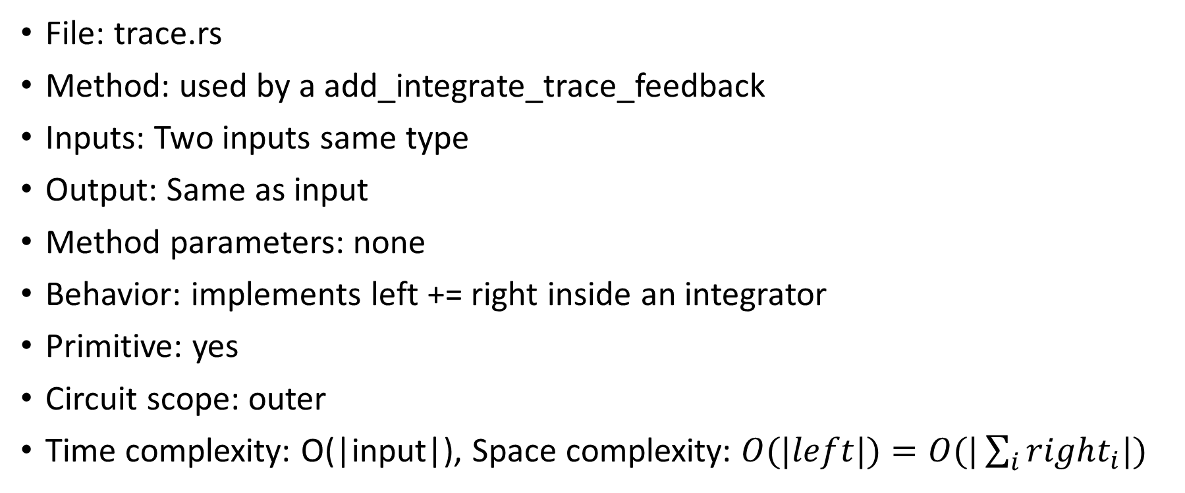
UntimedTraceAppend
File: trace.rs
Method: used by a add_integrate_trace_feedback
Inputs: Two inputs same type
Output: Same as input
Method parameters: none
Behavior: implements left += right inside an integrator
Primitive: yes
Circuit scope: outer
Time complexity: O(|input|), Space complexity: $O(|left|)=O(|\sum_{i}{right_{i}|)}$

Slide 90
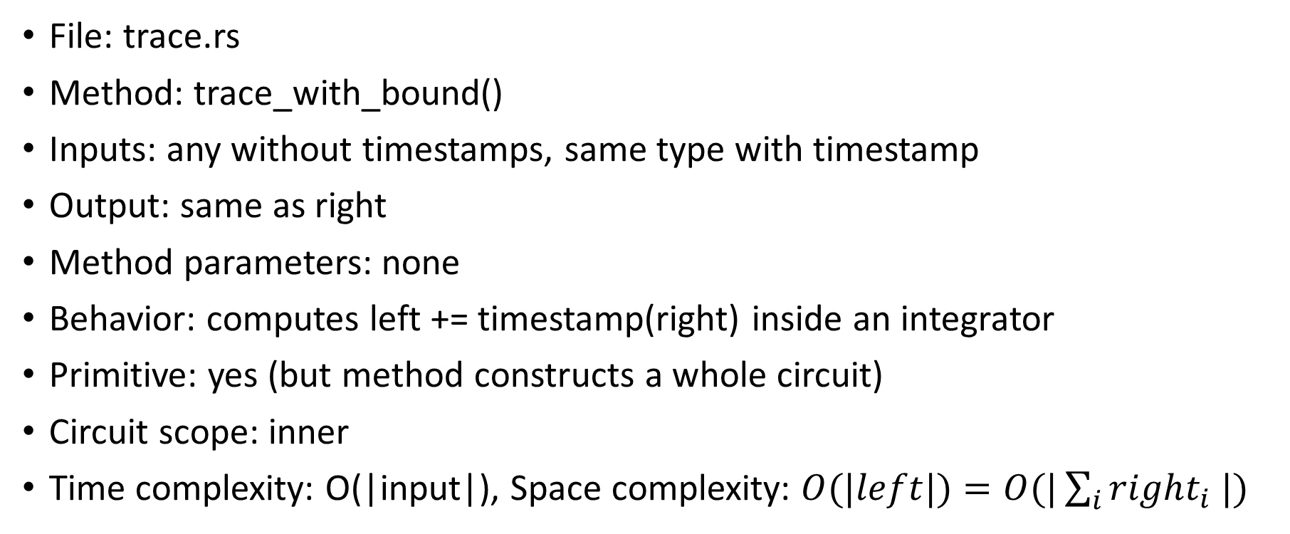
TraceAppend
File: trace.rs
Method: trace_with_bound()
Inputs: any without timestamps, same type with timestamp
Output: same as right
Method parameters: none
Behavior: computes left += timestamp(right) inside an integrator
Primitive: yes (but method constructs a whole circuit)
Circuit scope: inner
Time complexity: O(|input|), Space complexity: $O(|left|)=O(|\sum_{i}{right_{i} |)}$

Slide 91
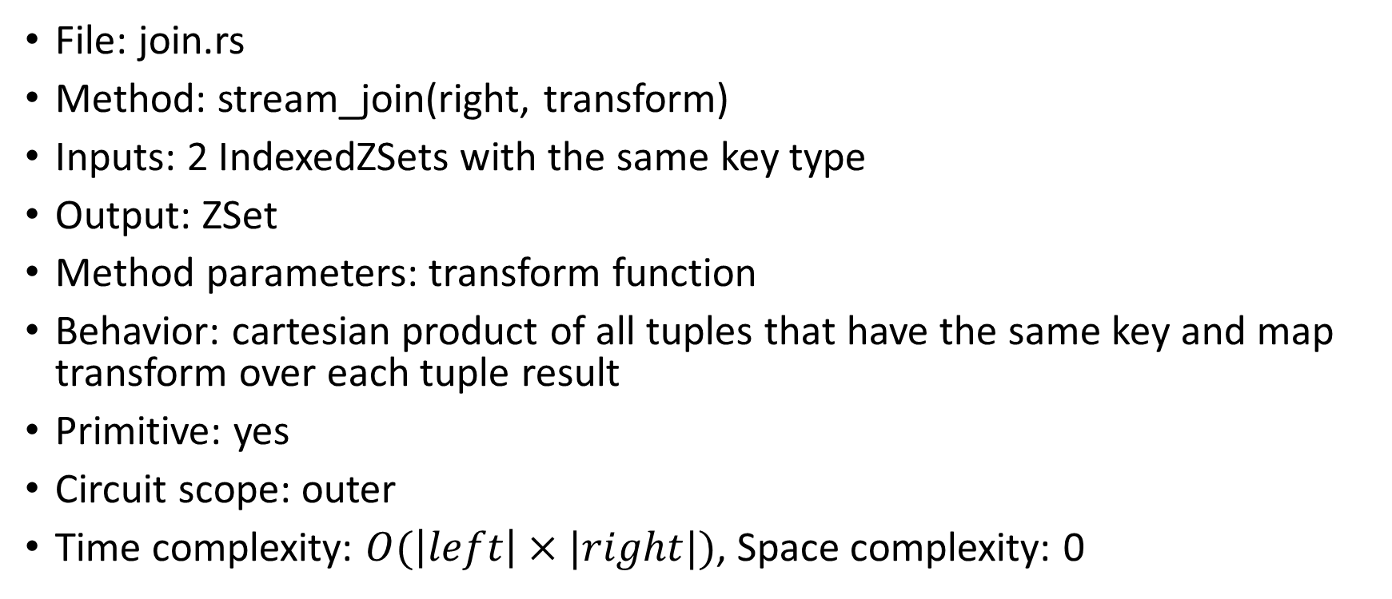
Join
File: join.rs
Method: stream_join(right, transform)
Inputs: 2 IndexedZSets with the same key type
Output: ZSet
Method parameters: transform function
Behavior: cartesian product of all tuples that have the same key and map transform over each tuple result
Primitive: yes
Circuit scope: outer
Time complexity: $O(\left|left\right|×|right|)$, Space complexity: 0

Slide 92
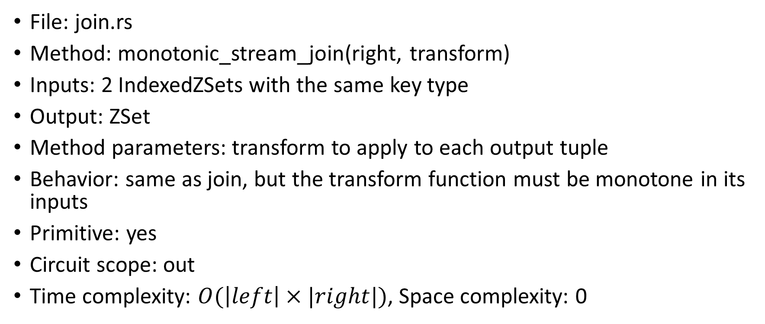
MonotonicJoin
File: join.rs
Method: monotonic_stream_join(right, transform)
Inputs: 2 IndexedZSets with the same key type
Output: ZSet
Method parameters: transform to apply to each output tuple
Behavior: same as join, but the transform function must be monotone in its inputs
Primitive: yes
Circuit scope: out
Time complexity: $O(\left|left\right|×|right|)$, Space complexity: 0

Slide 93
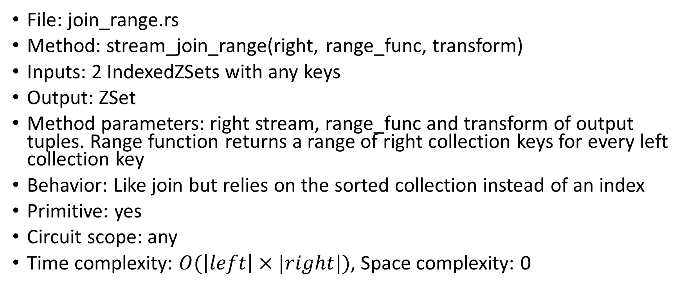
JoinRange
File: join_range.rs
Method: stream_join_range(right, range_func, transform)
Inputs: 2 IndexedZSets with any keys
Output: ZSet
Method parameters: right stream, range_func and transform of output tuples. Range function returns a range of right collection keys for every left collection key
Behavior: Like join but relies on the sorted collection instead of an index
Primitive: yes
Circuit scope: any
Time complexity: $O(\left|left\right|×|right|)$, Space complexity: 0

Slide 94
Z1Trace
File: trace.rs
Method: none – used internally
Inputs: Any 1
Output: Same as input
Method parameters: none
Behavior: Same as Z
Primitive: yes
Circuit scope: any
Time complexity: O(|input|), Space complexity: 0

Slide 95
Distinct
File: distinct.rs
Method: stream_distinct()
Inputs: Any 1
Output: Same as input
Method parameters: none
Behavior: the output has only elements with weight 1
Primitive: yes
Circuit scope: any
Time complexity: O(|input|), space complexity: 0

Slide 96
SemijoinStream
File: semijoin.rs
Method: semijoin_stream()
Inputs: 2 IndexedZSets with the same key type
Output: Same as left input
Method parameters: none
Behavior: Keep elements in left input that have a key in right input. Each weight is a sum of products.
Primitive: yes
Circuit scope: any
Time complexity: O(|left|+|right|), space complexity: 0

Slide 97
Aggregate
File: aggregate/mod.rs
Method: stream_aggregate(aggregator), stream_aggregate_generic()
Inputs: IndexedZSet
Output: ZSet
Method parameters: aggregator is a trait that requires two functions: aggregation and finalization
Behavior: Applies an aggregation function to each group associated with a key
Primitive: yes
Circuit scope: any
Time complexity: O(|input|), space complexity: 0

Slide 98
Count (non-incremental)
File: count.rs
Method: stream_weighted_count(aggregator), stream_weighted_count_generic()
Inputs: IndexedZSet
Output: ZSet
Method parameters: none
Behavior: Various specializations of stream_aggregate_* functions
Primitive: yes
Circuit scope: any
Time complexity: O(|input|), space complexity: 0

Slide 99
Composite “operators”
These methods expand into complex graphs of primitive operators

Slide 100
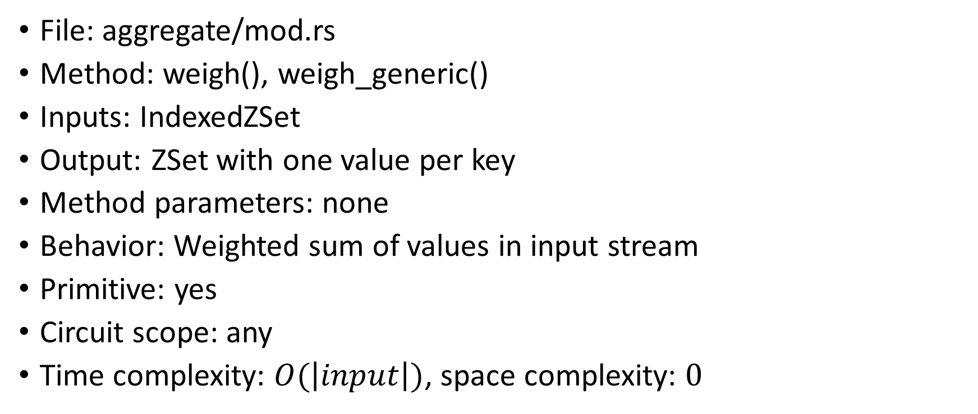
Methods: weigh
Apply
File: aggregate/mod.rs
Method: weigh(), weigh_generic()
Inputs: IndexedZSet
Output: ZSet with one value per key
Method parameters: none
Behavior: Weighted sum of values in input stream
Primitive: yes
Circuit scope: any
Time complexity: $O(\left|input\right|)$, space complexity: $0$

Slide 101
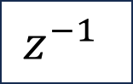
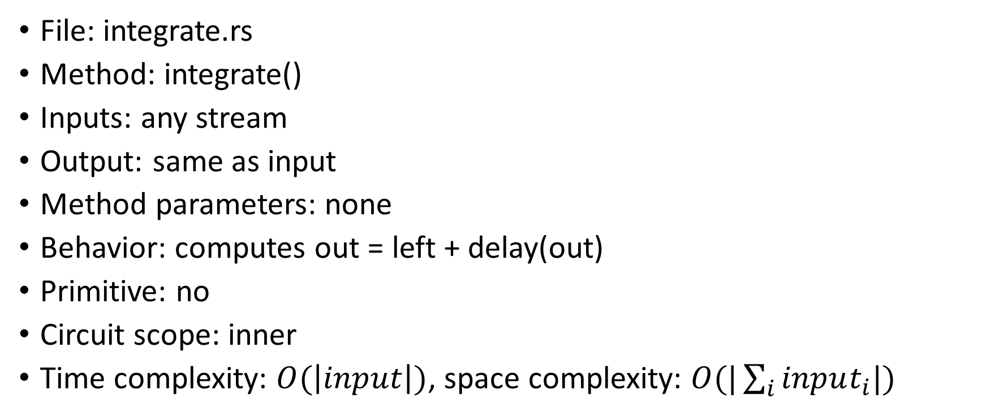
Method: integrate
+
$$z^{−1}$$
File: integrate.rs
Method: integrate()
Inputs: any stream
Output: same as input
Method parameters: none
Behavior: computes out = left + delay(out)
Primitive: no
Circuit scope: inner
Time complexity: $O(\left|input\right|)$, space complexity: $O(|\sum_{i}{input_{i}|})$

Slide 102

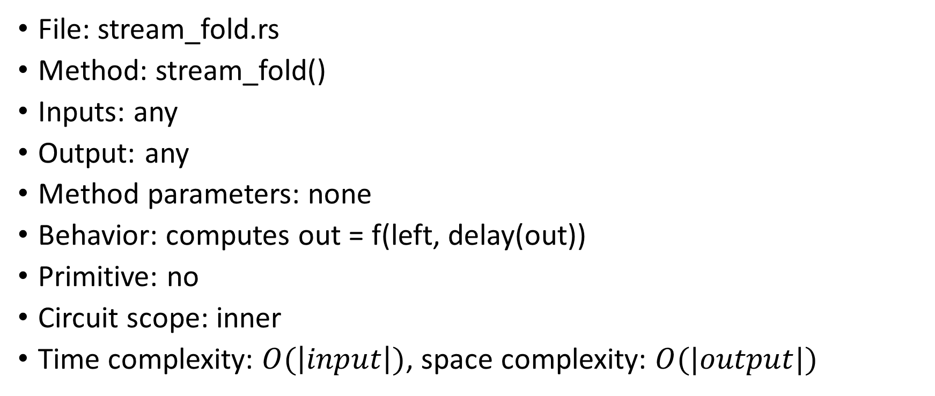
Method: stream_fold
Fold
$$z^{−1}$$
File: stream_fold.rs
Method: stream_fold()
Inputs: any
Output: any
Method parameters: none
Behavior: computes out = f(left, delay(out))
Primitive: no
Circuit scope: inner
Time complexity: $O(\left|input\right|)$, space complexity: $O(|output|)$

Slide 103
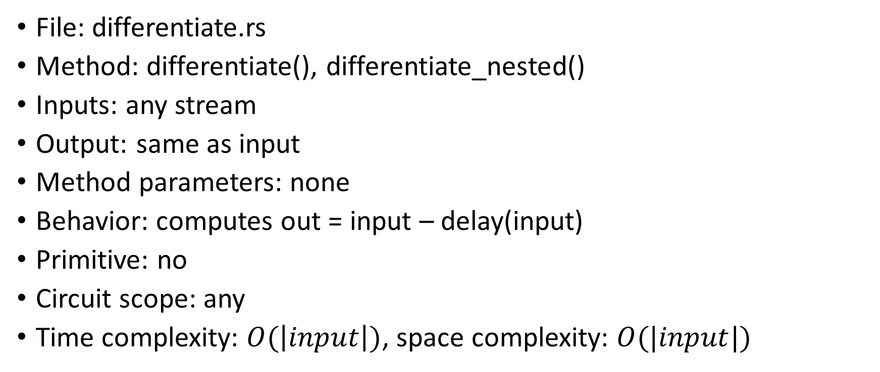
Methods: differentiate, differentiate_nested
-
$$z^{−1}$$
File: differentiate.rs
Method: differentiate(), differentiate_nested()
Inputs: any stream
Output: same as input
Method parameters: none
Behavior: computes out = input – delay(input)
Primitive: no
Circuit scope: any
Time complexity: $O(\left|input\right|)$, space complexity: $O(|input|)$

Slide 104
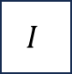
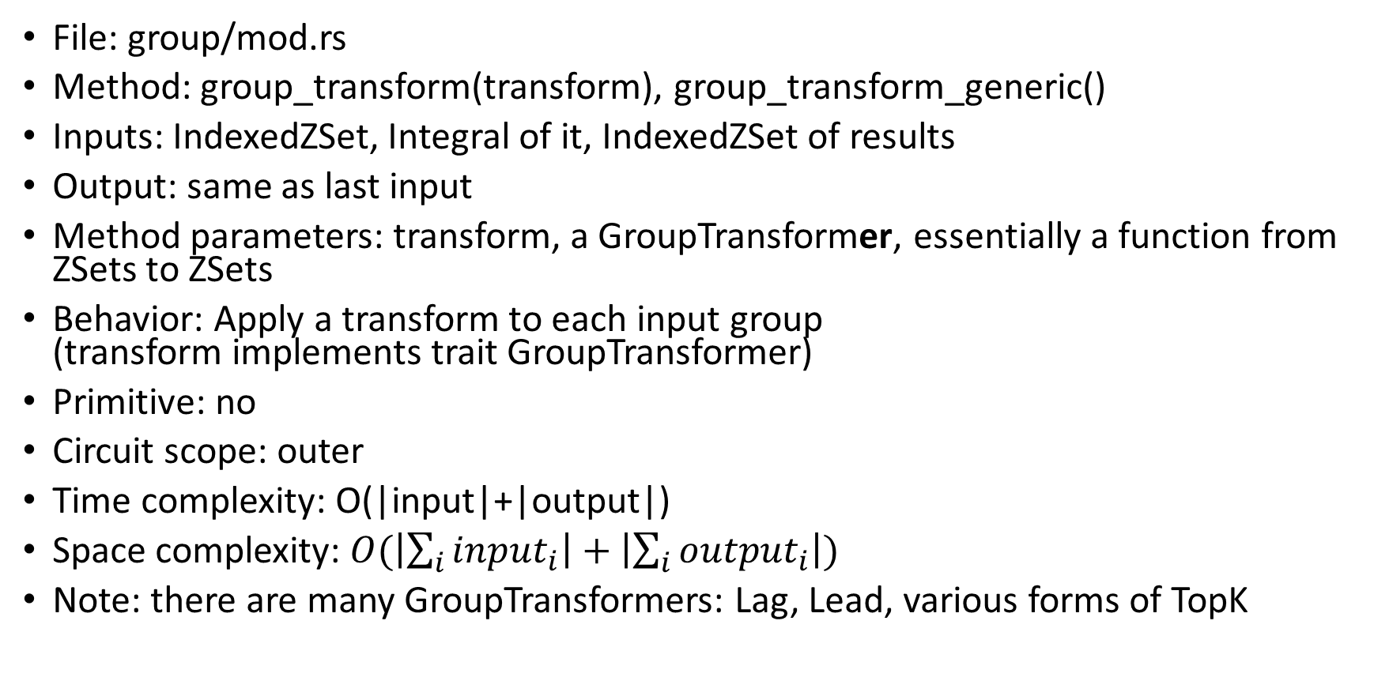
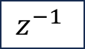


Method: group_transform
$$I$$
$$z^{−1}$$
GroupTransform
$$I$$
File: group/mod.rs
Method: group_transform(transform), group_transform_generic()
Inputs: IndexedZSet, Integral of it, IndexedZSet of results
Output: same as last input
Method parameters: transform, a GroupTransformer, essentially a function from ZSets to ZSets
Behavior: Apply a transform to each input group (transform implements trait GroupTransformer)
Primitive: no
Circuit scope: outer
Time complexity: O(|input|+|output|)
Space complexity: $O(\left|\sum_{i}{input_{i}}\right|+\left|\sum_{i}{output_{i}}\right|)$
Note: there are many GroupTransformers: Lag, Lead, various forms of TopK
$$z^{−1}$$

Slide 105

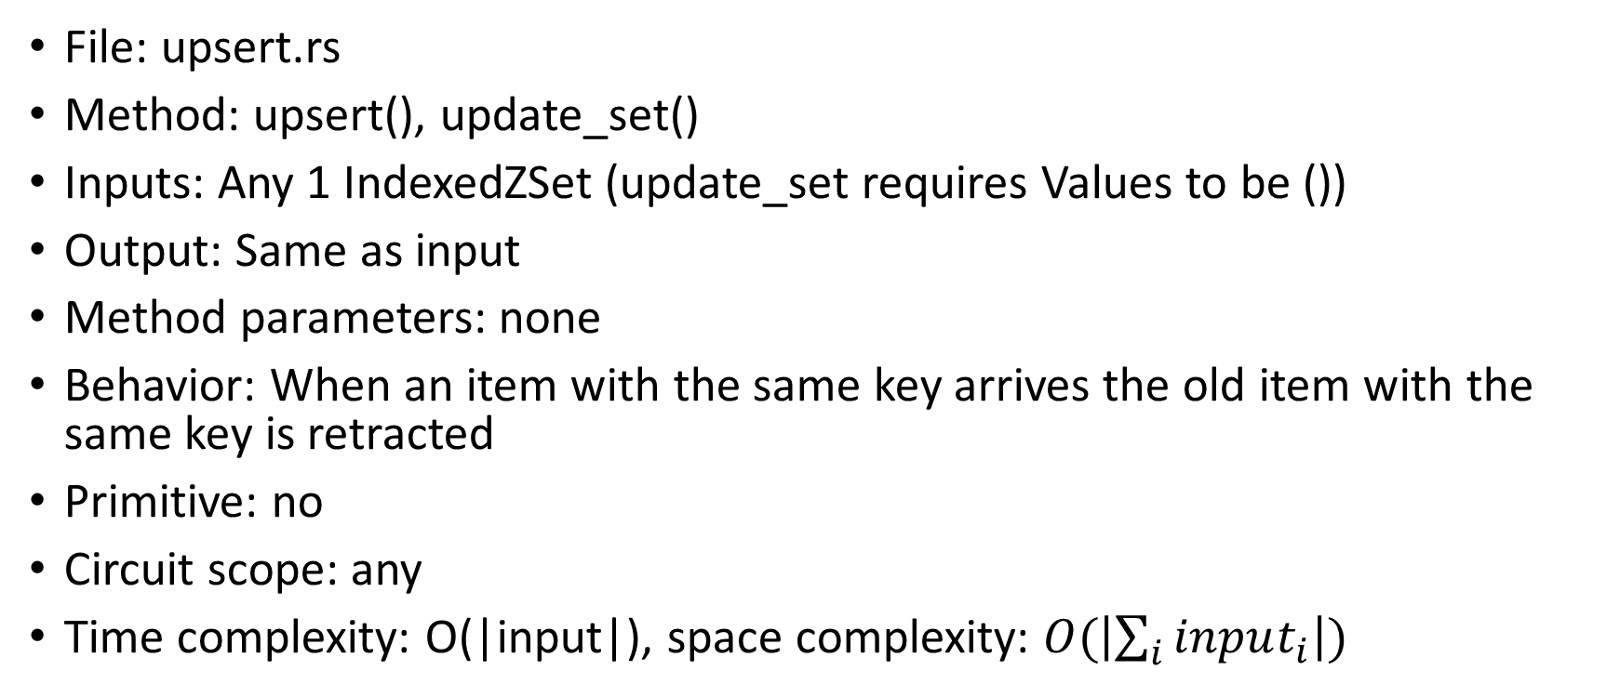
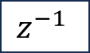
Methods: upsert, update_set
Upsert
$$I$$
File: upsert.rs
Method: upsert(), update_set()
Inputs: Any 1 IndexedZSet (update_set requires Values to be ())
Output: Same as input
Method parameters: none
Behavior: When an item with the same key arrives the old item with the same key is retracted
Primitive: no
Circuit scope: any
Time complexity: O(|input|), space complexity: $O(\left|\sum_{i}{input_{i}}\right|)$
$$z^{−1}$$

Slide 106
Method: stream_aggregate_linear
weigh
stream_aggregate_generic
Apply
Aggregate
File: aggregate/mod.rs
Method: stream_aggregate_linear(), stream_aggregate_linear_generic()
Inputs: IndexedZSet
Output: ZSet
Method parameters: aggregator is a trait that requires two functions: aggregation and finalization
Behavior: Applies an aggregation function to each group associated with a key
Primitive: no
Circuit scope: any
Time complexity: O(|input|), space complexity: 0

Slide 107




Methods: aggregate, aggregate_generic
$$I$$
AggregateIncremental
Upsert
$$I$$
File: aggregate/mod.rs
Method: aggregate(aggregator), aggregate_generic()
Inputs: IndexedZSet
Output: ZSet
Method parameters: Same as Aggregate
Behavior: Incremental version of Aggregate: for each input change it will output an insertion for each modified group key. The upsert operator generates the corresponding deletion
Primitive: no
Circuit scope: any
Time complexity: O(|input|)
Space complexity: $O(\left|\sum_{i}{input_{i}}\right|+|\sum_{i}{output_{i}}|)$
$$z^{−1}$$
upsert()

Slide 108



Methods: aggregate_linear
aggregate
weigh
Apply
$$I$$
AggregateIncremental
Upsert
$$I$$
File: aggregate/mod.rs
Method: aggregate_linear(), aggregate_linear_generic()
Inputs: IndexedZSet
Output: ZSet with one value per key
Method parameters: none
Behavior: Weighted sum of values in input stream
Primitive: no
Circuit scope: any
Time complexity: $O\left(\left|input\right|\right)$
Space complexity:$O(\left|\sum_{i}{{keys}_{i}}\right|)$
$$z^{−1}$$
upsert

Slide 109


Method: distinct_count
$$I$$
DistinctIncremental
Apply
distinct
File: count.rs
Method: distinct_count(), distinct_count_generic(), stream_distinct_count(), stream_distinct_count_generic()
Inputs: IndexedZSet
Output: ZSet
Method parameters: none
Behavior: Count weights in input stream
Primitive: no
Circuit scope: any
Time complexity: O(|input|), space complexity: $O(\left|\sum_{i}{input_{i}}\right|)$

Slide 110
Method: stream_distinct_count
stream_aggregate_linear
stream_distinct
weigh
Distinct
Apply
Aggregate
File: count.rs
Method: distinct_count(), distinct_count_generic()
Inputs: IndexedZSet
Output: ZSet
Method parameters: none
Behavior: Count weights in input stream
Primitive: no
Circuit scope: any
Time complexity: O(|input|), space complexity: 0

Slide 111




Method: weighted_count
aggregate
weigh
Apply
$$I$$
AggregateIncremental
Upsert
$$I$$
$$z^{−1}$$
File: count.rs
Method: weighted_count(aggregator), weighted_count_generic()
Inputs: IndexedZSet
Output: ZSet
Method parameters: none
Behavior: Various specializations of aggregate_linear* functions
Primitive: no
Circuit scope: any
Time complexity: O(|input|)
Space complexity: $O(\left|\sum_{i}{keys_{i}}\right|)$
upsert

Slide 112




Method: average
aggregate_linear
upsert
Apply
weigh
Apply
$$I$$
AggregateIncremental
Upsert
$$I$$
File: aggregate/average.rs
Method: average()
Inputs: IndexedZSet
Output: ZSet
Method parameters: none
Behavior: efficient implementation of average
Primitive: no
Circuit scope: any
Time complexity: $O\left(\left|input\right|\right)$
Space complexity: $O(\left|\sum_{i}{keys_{i}}\right|)$
$$z^{−1}$$

Slide 113


Method: distinct()
$$I$$
DistinctIncremental
File: distinct.rs
Method: distinct()
Inputs: Any 1
Output: Same as input
Method parameters: none
Behavior: Version of distinct that operates on changes (H from the paper). The Total version is used in the outermost circuit scope
Primitive: no
Circuit scope: any
Time complexity: O(|input|), space complexity: $O(\left|\sum_{i}{input_{i}}\right|)$

Slide 114





Methods: join, join_index
$$I$$
JoinTrace
$$+$$
$$I$$
$$z^{−1}$$
JoinTrace
File: join.rs
Method: join(right, transform), join_generic(right, transform), join_index()
Inputs: Any two IndexedZSets with the same key type and any timestamp
Output: A ZSet with the same timestamp
Method parameters: stream, transform to apply to each tuple
Behavior: correctly computes a lifted join in a circuit with any nesting
Primitive: no
Circuit scope: any
Time complexity: $O(\left|left\right|×|\sum_{i}{right_{i}}|+|\sum_{i}{left_{i}}|×\left|right\right|)$,
Space complexity: $O(|\sum_{i}{right_{i}|+|\sum_{i}{left_{i} |)}}$

Slide 115






Method: antijoin
$$−$$
$$I$$
JoinTrace
$$+$$
File: join.rs
Method: antijoin()
Inputs: any two IndexedZSets with the same key type
Output: same as input
Method parameters: none
Behavior: keep items from left collection that have no keys in the right collection
Primitive: no
Circuit scope: any
Time complexity: $O(\left|left\right|×|right|)$, space complexity: 0
Distinct
$$I$$
$$z^{−1}$$
JoinTrace
join

Slide 116




Method: tree_aggregate
$$I$$
RadixTreeAggregate
$$I$$
$$z^{−1}$$
File: time_series/radix_tree/tree_aggregate.rs
Method: tree_aggregate(aggregator), tree_aggregate_generic()
Inputs: IndexedZSet indexed by an integer “timestamp”
Output: A stream of RadixTrees (not ZSets!)
Method parameters: aggregator
Behavior: creates a trace of tree changes; internal nodes are aggregates applied to all leaf nodes.
Primitive: no
Circuit scope: outer
Time complexity: O(|input|),
Space complexity: $O(\left|\sum_{i}{input_{i}}\right|+\left|\sum_{i}{output_{i}}\right|)$

Slide 117




Method: partitioned_tree_aggregate
$$I$$
PartitionedRadix TreeAggregate
$$I$$
File: time_series/radix_tree/partitioned_tree_aggregate.rs
Method: partitioned_tree_aggregate(aggregator), partitioned_tree_aggregate_generic()
Inputs: PartitionedIndexedZSet: An IndexedZSet where the keys have a pair structure, with “Partition” and “Timestamp” fields
Output: PartitionedRadixTree
Method parameters: aggregator
Behavior: From deltas to a (time series) stream, compute deltas to a radix tree
Primitive: no
Circuit scope: outer
Time complexity: O(|input|)
Space complexity: $O(\left|\sum_{i}{input_{i}}\right|+\left|\sum_{i}{output_{i}}\right|)$
$$z^{−1}$$

Slide 118





Method: partitioned_rolling_aggregate
File: time_series/rolling_aggregate.rs
Method: partitioned_rolling_aggregate( aggregator, range), partitioned_rolling_aggregate_generic()
Inputs: stream of PartitionedIndexedZSet, aggregator, interval
Output: Same as left input
Method parameters: aggregator, and an interval description
Behavior: for each partition and each row aggregate data from the partition around the specified interval around the row
Primitive: no
Circuit scope: outer
Time complexity: O(|input|)
Space complexity: $O(\left|\sum_{i}{input_{i}}\right|+\left|\sum_{i}{output_{i}}\right|)$
$$I$$
PartitionedRolling Aggregate
$$I$$
$$z^{−1}$$
partitioned_tree_aggregate
$$I$$
PartitionedRadix TreeAggregate
$$I$$
$$z^{−1}$$

Slide 119



Method: window
$$I$$
$$z^{−1}$$
Window
File: time_series/window.rs
Method: window(stream, bounds stream)
Inputs: IndexedZSets, stream of pairs of keys for left input
Output: Same as left input
Method parameters: stream, window bounds
Behavior: Window bounds are supposed both grow monotonically. The circuit produced emits changes to the current window
Primitive: no
Circuit scope: outer
Time complexity: O(|input|), space complexity: $O(\left|\sum_{i}{input_{i}}\right|)$

Slide 120

Method: waterline
Fold
$$z^{−1}$$
File: time_series/waterline.rs
Method: waterline(init, extract, max), waterline_monotonic(init, extract)
Inputs: Any
Output: Stream of timestamp extracted
Method parameters: initial value of output timestamp, function that extracts a timestamp from the input stream values, and a function that computes the max of two timestamps. The monotonic version assumes that the last value is the max.
Behavior: A specialization of stream_fold
Primitive: no
Circuit scope: outer
Time complexity: $O(\left|input\right|)$, space complexity: $O(|output|)$

Slide 121
Internal operators
These operators are used by DBSP internally

Slide 122
DelayedTrace
File: trace.rs
Method: delay_trace()
Inputs: Any 1, but must be the output of a Trace operator
Output: Same as input
Method parameters: none
Behavior: Delays the input trace (integrator)
Primitive: yes
Circuit scope: any
Time complexity: O(|input|), space complexity: O(|input|)

Slide 123

NeighborhoodLocal, NeighborhoodNumbered
File: neighborhood.rs
Method: neighborhood(data, description)
Inputs: Any, a description of a pivot row and a window
Output: A stream of neighborhoods (not Zset or IndexedZSets!)
Method parameters: data, description of window
Behavior: in every clock cycle returns the data around the specified row
Primitive: no; it integrates, collects, differentiates, numbers, gathers
Circuit scope: any
Time complexity: $O(\left|input\right|)$, space complexity: $0$

Slide 124

SampleKeys
File: sample.rs
Method: stream_sample_keys()
Inputs: ZSet, stream<usize> (not a zset!)
Output: Zset same as left input
Method parameters: sample size for each clock cycle
Behavior: non-deterministically extract the specified number of rows from the stream
Primitive: yes (stream_sample_keys produces a SampleKeys and a Gather)
Circuit scope: any
Time complexity: $O(\left|input\right|)$, space complexity: $0$

Slide 125

SampleUniqueKeyVals
File: sample.rs
Method: stream_sample_unique_key_vals(data, size)
Inputs: any IndexedZSet, any stream of sizes
Output: same as left input
Method parameters: sample size for each clock cycle
Behavior: same as stream.map(|(k,v)| (k,v)).stream_sample_keys()
Primitive: yes
Circuit scope: any
Time complexity: $O(\left|input\right|)$, space complexity: $0$

Slide 126

Shard
C
File: communication/shard.rs
Method: shard(receiver thread)
Inputs: Any
Output: Any
Method parameters: None
Behavior: Used to partition data into multiple. Sum of outputs is the input
Primitive: no
Circuit scope: any
Time complexity: $O(\left|input\right|)$, space complexity: $0$
P
C
C

Slide 127

EmptyGatherConsumer, GatherProducer, GatherConsumer
P
File: gather.rs
Method: gather(receiver thread)
Inputs: Any
Output: Any
Method parameters: None
Behavior: Used to collect data from multiple shards of an operator into a single shard. Output is the sum of all inputs
Primitive: no
Circuit scope: any
Time complexity: $O(\left|input\right|)$, space complexity: $0$
P
C
P

Slide 128

ExchangeSender, ExchangeReceiver
S
R
File: communication/exchange.rs
Method: add_exchange()
Inputs: any
Output: any
Method parameters: data partitioning function
Behavior: repartitions data between threads according to the specified function
Primitive: no
Circuit scope: any
Time complexity: $O(\left|input\right|)$, space complexity: $0$
S
R
S
R

Slide 129
Waterline dataflow analysis
Goal: compute on infinite tables with finite memory
Infinite tables: only positive deltas

